Slide 1
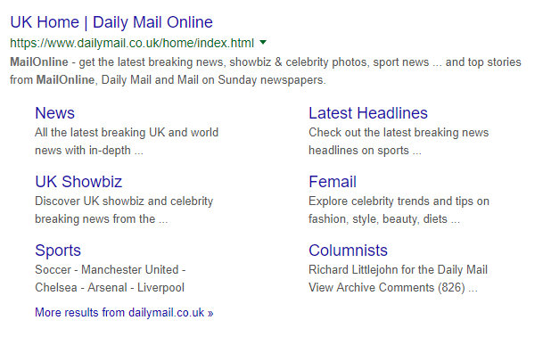
What can we infer about The Mail Online from search engines?

Slide 2
LO: To investigate the genre codes of mid-market papers (Daily Mail) identify key conventions of online news websites
Key questions to ask:
What are the common representations shown in news stories
What does this say about the audience? Think about age, political ideology, cultural codes and social contexts.
Why are the stories presented in this way
How can audiences read or interpret these stories
How do these compare to other online news sites
Could the news stories be repacked differently on social media, if so how?

Slide 3
Online and participatory media
The following stories and page snaps from The Mail are all from the same day and appeared on the main page of their website.
Consider issues of media language, representation and look for trends or patterns in terms of newspaper content and news values.

Slide 5
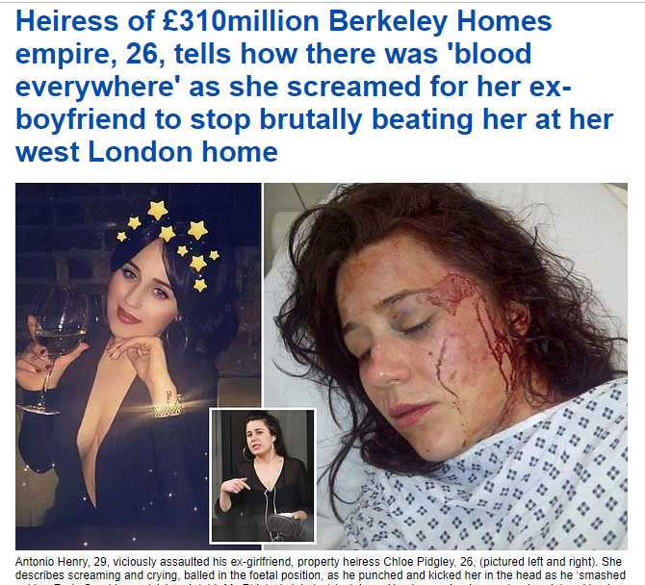

Slide 6
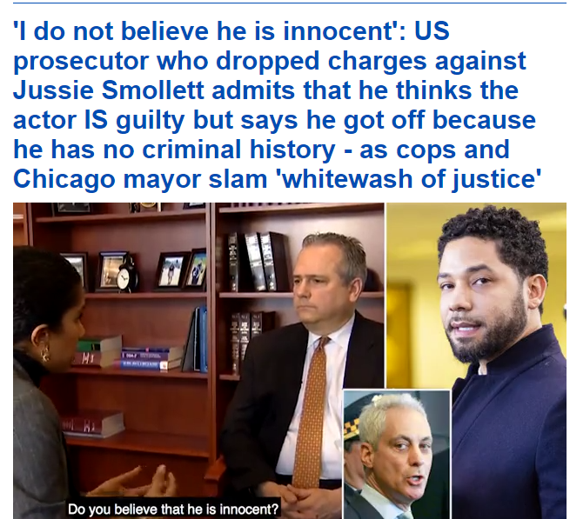

Slide 7
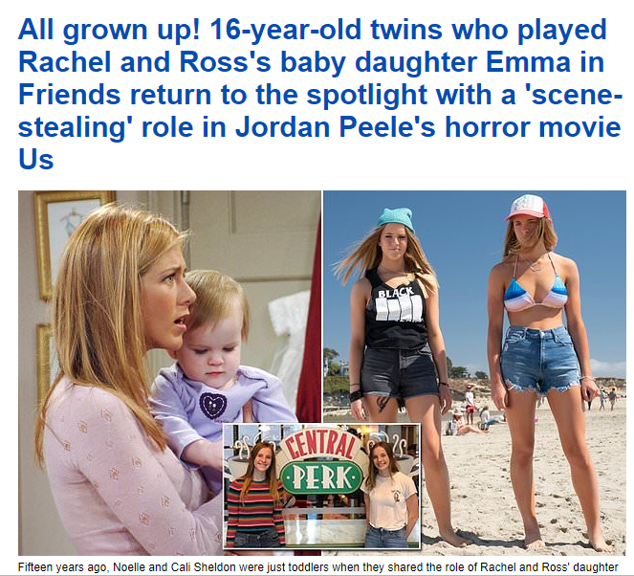

Slide 8
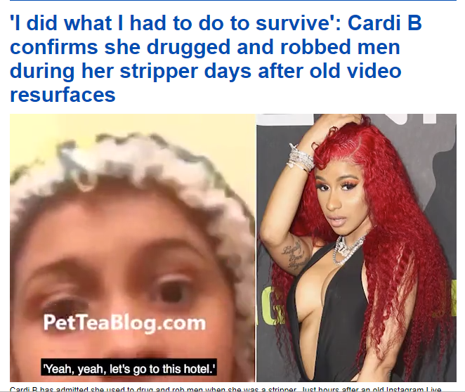

Slide 9
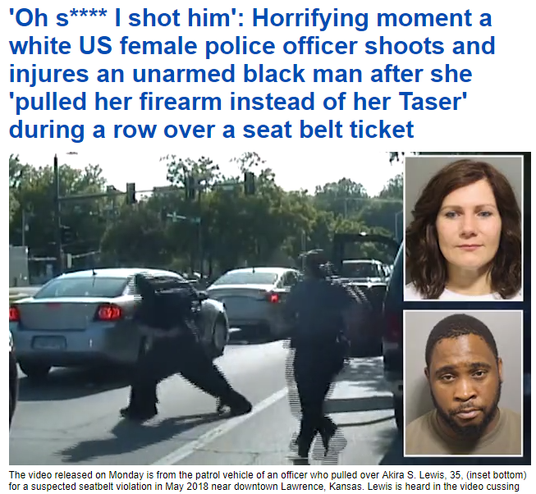

Slide 10
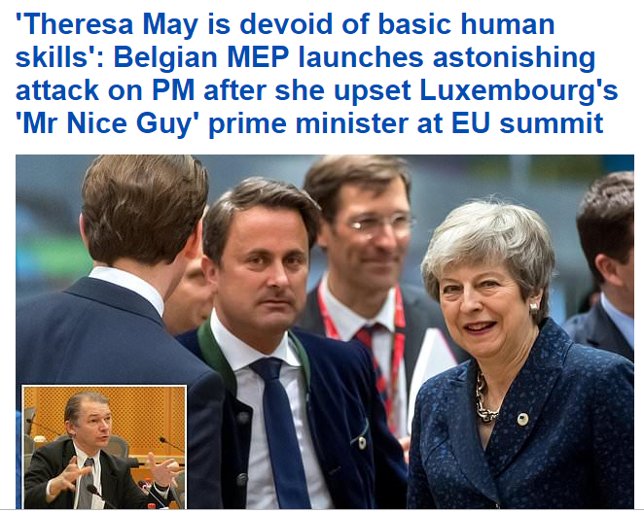

Slide 11
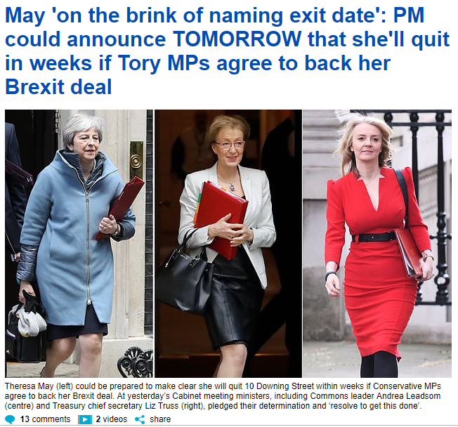

Slide 12
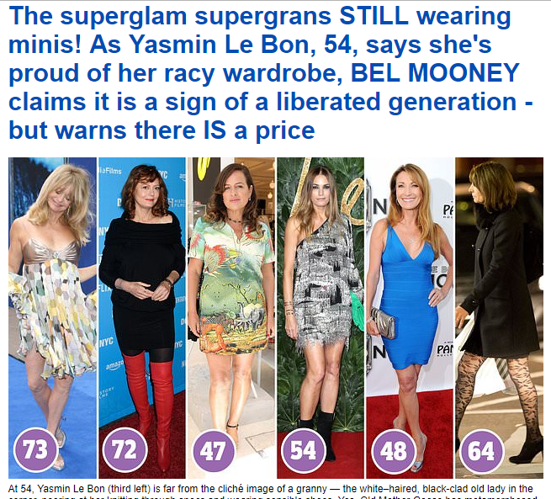

Slide 13
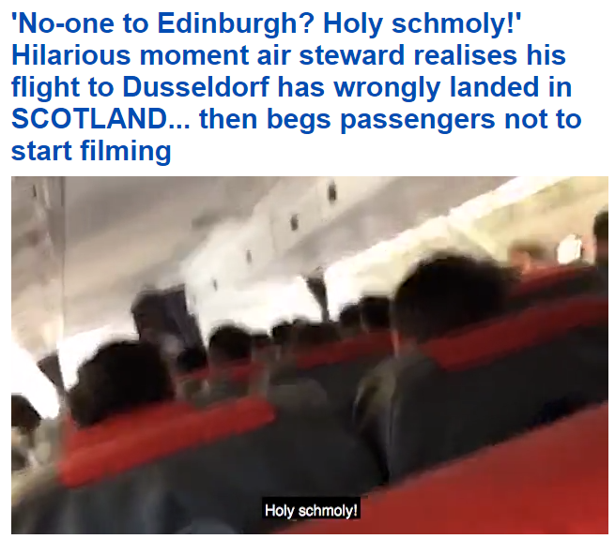

Slide 14
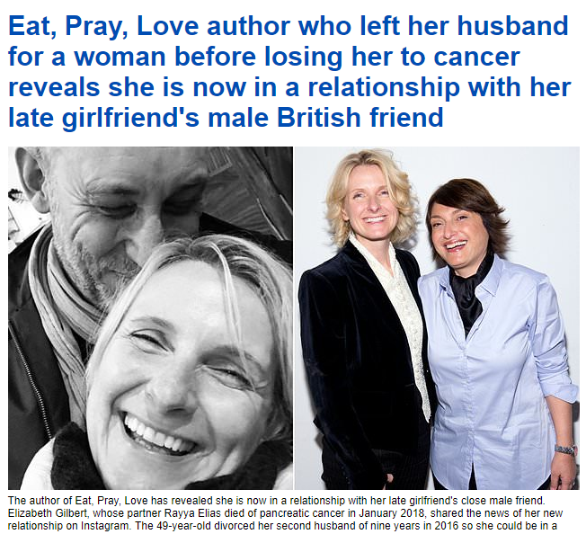

Slide 15
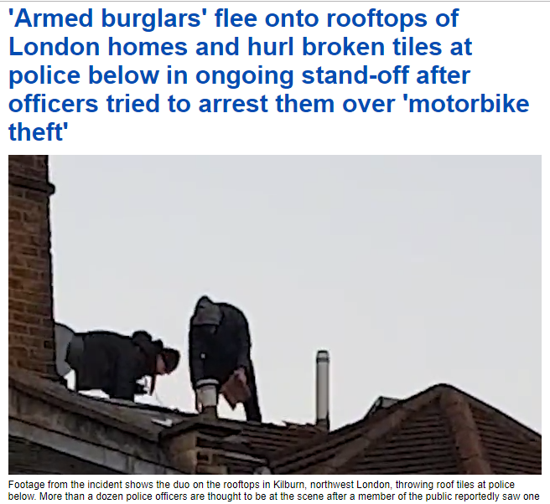

Slide 16
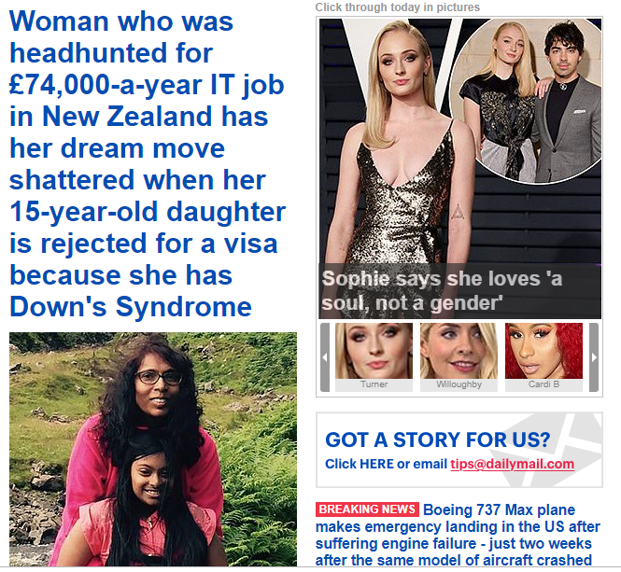

Slide 17
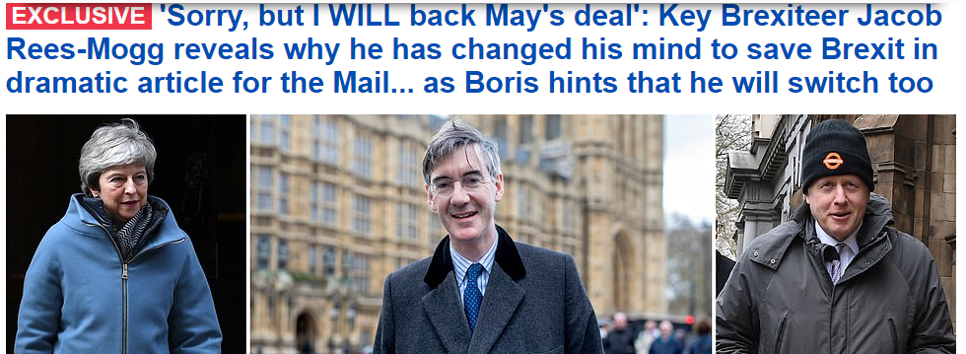

Slide 18
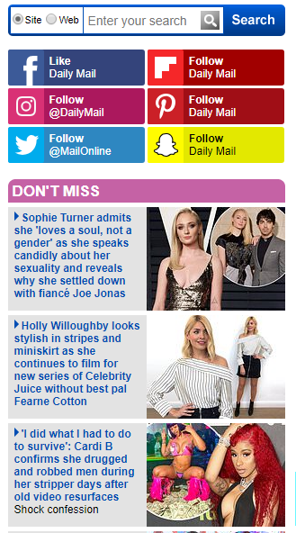

Slide 19
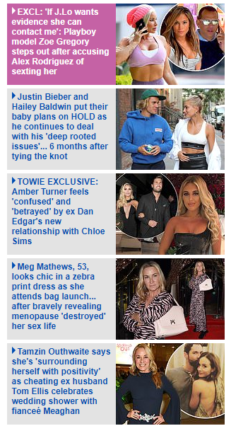

Slide 20
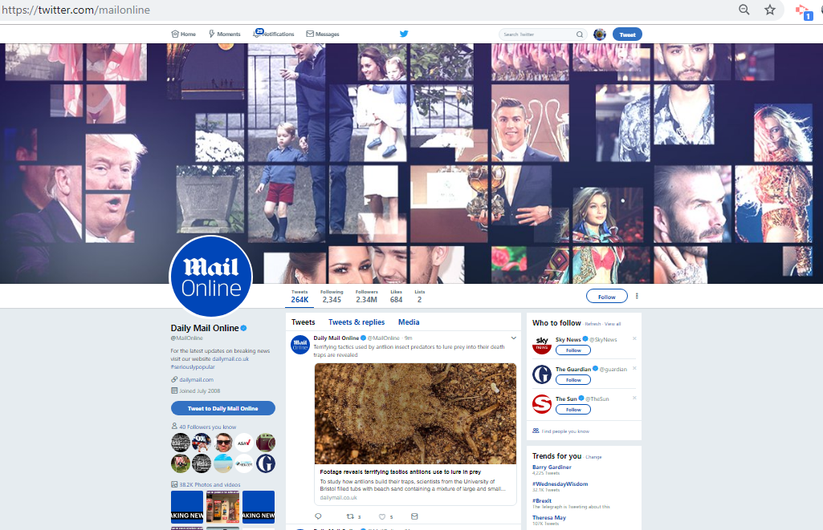

Slide 21
